Slide 1
Performance and Power profiling on Intel® Android* devices
Kevin O’Leary – Technical Consulting Engineer - Intel
Notes:
Note: This slide deck also goes over the features of:
Intel VTune Amplifier 2013 u5/u6 (which are NDA products – there is an NDA Add On Presentation that explains the differences)

Slide 2
Agenda
Overview
Intel® System Studio 2016
Intel® VTune™ Amplifier 2016 for Systems
Intel® Energy Profiler
Performance Analysis
Steps to analyze your Android* device
Power Analysis
Power Optimization Basics
Power Views in the VTune Amplifier GUI
How to Collect:
SoCWatch

Slide 3
Overview

Slide 4
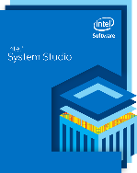

Intel® System Studio for Android* Deep System Insight for Mobile System Developers
IA Coverage
In-depth
Analysis & Debug
SoC, CPU, and GPU analysis
System Debug & Trace
Advanced system debug & trace for greater system stability
SoC-wide analysis for enhanced power efficiency and performance
Graphics Performance Analysis and optimization tools for graphics-intensive applications
Industry-leading performance from exceptional C++ Compiler and libraries
Smartphone and Tablet
Support for Latest Intel Processor and SoC
OS Support
Boost Performance
Windows* and Linux* host
Android* Target
From single to multicore
High performance libraries
Notes:
More IA Coverage. Broad OS Support. Best Performance. In-depth Analysis & Debug

Slide 5



Intel® System Studio for Android* Overview
Integrated software tool suite that provides deep system-wide insight to help:
Accelerate Time To Market
Strengthen System Reliability
Boost Power Efficiency and Performance
Debug
Analyze
Write and Test Code
Intel® JTAG Debugger
System
Intel® VTuneTM Amplifier
Intel® Graphics Performance Analyzers (System Analyzer)
Intel® Energy Profiler
Power & Performance
Intel® C/C++ Compiler
Intel® Integrated Performance Primitives Preview
Intel® Hardware Acclerated Execution Manager
Application
JTAG
Interface
System and Application Code
Intel® Processor-based Mobile Systems

Slide 6
Intel® System Studio 2016 Components
 | 6 | Target OS Support
 |  | Linux* ^{1, 5} |  |  | Android* ⁵ |  |  | Windows* |  | VxWorks*
Category | Component | ^{Composer Edition} | ^{Professional Edition} | ^{Ultimate Edition} | ^{Composer Edition} | ^{Professional Edition} | ^{Ultimate Edition} | ^{Composer Edition} | ^{Professional Edition} | ^{Composer Edition}
Host Operating Systems |  | Linux*, Windows* |  |  | Linux*, Windows* |  |  | Windows* |  | Linux*, Windows*
Integrated Development Environment |  | Eclipse*, Wind River* Workbench* |  |  | Eclipse* |  |  | Visual Studio* |  | Wind River* Workbench*
Compiler & Libraries | Intel® C++ Compiler | √ | √ | √ | √ | √ | √ | √ | √ | √ ²
 | Intel® Integrated Performance Primitives | √ | √ | √ | √ | √ | √ | √ | √ | √ ²
 | Intel® Math Kernel Library | √ | √ | √ |  |  |  | √ | √
 | Intel® Threading Building Blocks | √ | √ | √ | √ | √ | √ | √ | √
Application Debugger | Intel-enhanced GDB* Application Debugger | √ | √ | √ | √ | √ | √
Analyzers | Intel® VTune™ Amplifier for Systems |  | √ | √ |  | √ | √ |  | √
 | Intel® Energy Profiler |  |  |  |  | √ | √ |  | √
 | System Analyzer |  |  |  |  | √ | √ |  | √
 | Frame Analyzer ⁴ |  |  |  |  | √ | √ |  | √
 | Platform Analyzer ⁴ |  |  |  |  | √ | √ |  | √
 | Intel® Inspector for Systems |  | √ | √ |  |  |  |  | √
System Debugger | Intel® System Debugger (JTAG) ³ |  |  | √ |  |  | √
¹ Linux*, Embedded Linux, Wind River* Linux*, Yocto Project*, Tizen*
² Delivered with Wind River* VxWorks* platform* ³ Via Intel® ITP-XDP3 probe, OpenOCD*, Macraigor* usb2demon* and EDKII* for UEFI*
⁴ Available on Windows* host only
⁵ Linux* and Android* target support available in a single product
Notes:
Here is a mapping of ISS components to target Operating Systems and packages.
The key components of ISS are grouped into
The key differentiator between Ultimate Edition and Pro Edition is the JTAG-based Intel System Debugger – a solution that OEMs, and System Integrators are seeking for.
The Linux and Android target support comes with one package, either Composer, Professional or Ultimate solution. As mentioned, Windows target support is a new offering we are providing with ISS 2015.
For those who develop embedded systems based on Wind River VxWorks, a compiler and certain libraries are available too. These can be obtained through Wind River Systems

Slide 7
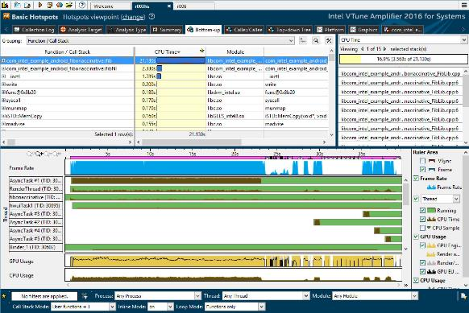
Intel® VTune™ Amplifier for Systems Performance Profiler
Get the Tuning Data You Need
Low overhead “hotspot” analysis with call stacks
Advanced analysis for cache, branching, …
Find Answers Fast
Powerful analysis & data mining
Results mapped to C/C++ or Java source
Easy to Use
Remote analysis from the User Interface
Windows or Linux Host analyzes Linux or Android target
Optimize Your Software Performance
Notes:
Note: If you have a Intel Reference Design Platform - Contact Intel BDM or to get the NDA version of this product = Intel VTune for Android u5 | u6 –or- NDA Version add-on
The Tuning Data You Need – we can collect many different kinds of data that will help diagnose your apps performance
Find Answers fast – collecting data is not enough, you need to be able to interpret it and make sense of it. We have a strong set of analysis tools to help you interpret the data.
Easy to use – tuning is hard. But running the profiler doesn’t have to be.

Slide 8
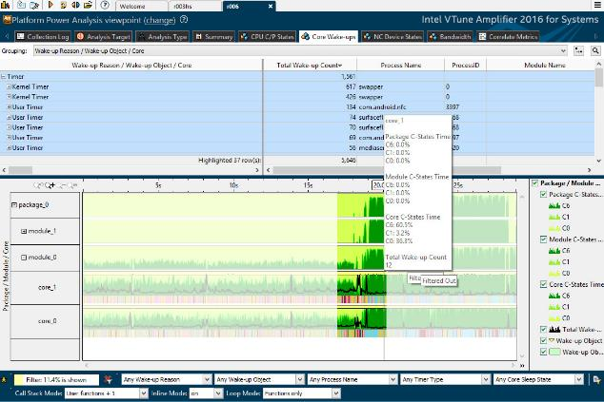
Intel® Energy Profiler Energy and Power Profiler for System Software Developers
Optimize software for extended Battery Life
Find the system behaviors that waste energy
Interrupts mapped to the IRQ/device
Timers mapped to the scheduling process
Data correlated with Android Wake Locks
Available now for Linux and Android
Part of Intel® System Studio
Requires specific SOCs. On Android, a rootable OS is required with version compatible device drivers. See release notes for details.
Get Actionable Data to Extend Battery Life
Notes:
Unlike other tools that measure average power usage, Intel® Energy Profiler identifies the cause of the wake ups that waste energy. Interrupts are mapped to the IRQ/device and timers are mapped to the process that scheduled them. This gives you actionable information to reduce / consolidate wake-ups and save energy by remaining in a low power state for a longer period of time.
Device State Data – Power-up Only What Is Needed
See what devices are using power and when. Make sure unused devices are off. See if the correct device is being used. E.g., is audio decode is running on the CPU when it should be on the audio decode unit? (Android only)
Correlated Data Provides Clues to the Root Cause
See multiple metrics on the same timeline for faster diagnosis of the root cause.

Slide 9
What’s New In Intel® VTune™ Amplifier 2016 for Systems
Android Support including…
Basic hotspots, Locks & Waits and EBS with stacks for RT kernel and RT applications for Linux Targets
EBS based stack sampling for kernel mode threads
Support for Intel® Atom™ x7 Z8700 & x5 Z8500/X8400 processor series (Cherry Trail) including GPU analysis
Automated remote EBS analysis on SoFIA (by leveraging existing sampling driver on target)
Super Tiny display mode added for the Timeline pane to easily identify problem areas for results with multiple processes/threads
Platform window replacing Tasks and Frames window and providing CPU, GPU, and Bandwidth metrics data distributed over time
General Exploration analysis views extended to display confidence indication (greyed out font) for non-reliable metrics data resulted, for example, from the low number of collected samples
GPU usage analysis for OpenCL™ applications extended to display compute-originated batch buffers on the GPU software queue in the Timeline pane (Linux* target only)
New filtering mode for command line reports to display data for the specified column names only
Continually expanding Mobile Development Kit Program - http://software.intel.com/mdk
Many other features for embedded OS’s, improvements to the GUI, and various bug fixes…
See Release Notes
9
Notes:
For some this slide may not make much sense….
As all these “Android” features are “new” for the public in Intel VTune Amplifier 2014 for Systems in ISS 2014
But for those who were using the NDA version of Intel® VTune Amplifier 2013 for Android – Some of these features are new

Slide 10
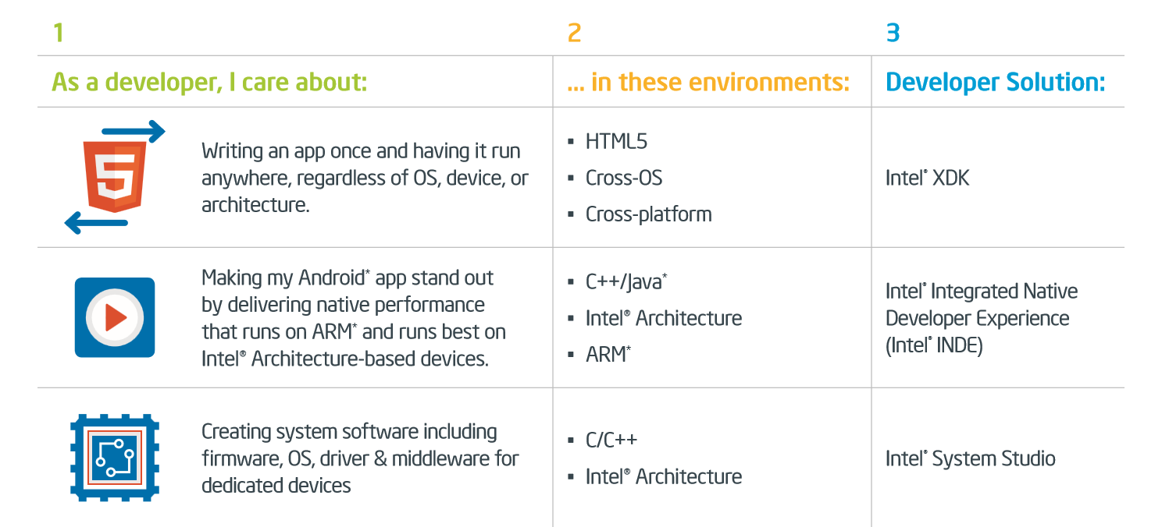
Other Intel® Software Developer Tools for Android*
10
Notes:
http://xdk-software.intel.com
http://software.intel.com/en-us/intel-inde

Slide 11
Performance Analysis
Using Intel® VTune™ Amplifier 2016 for Systems on Android* Systems

Slide 12
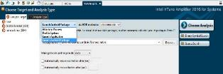
Overview of Remote/Attached Collection Procedure/Architecture for Android*
Host
GUI Collector Control
VTune GUI
Target device
amplxe-cl
VTune collector binary runs on target and stores result on target
adb
amplxe-runss
control collection
VTune result
adb
VTune result
transfer data/modules
Data is opened in GUI and symbols are resolved using modules stored in result dir
User can specify search dir with separate debug files if needed
driver
Some collection types require signed drivers accessed from rooted device
Transfers data collected remotely back to host automatically together with stripped application modules for symbol resolution
Uses “adb” protocol/binary for collection & data transfer (must be in path)
Flexible collection configuration + control (pause/resume/stop)

Slide 13
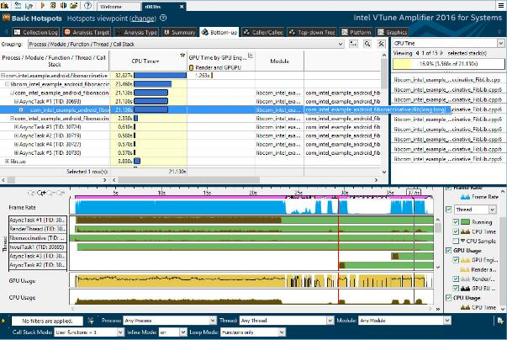
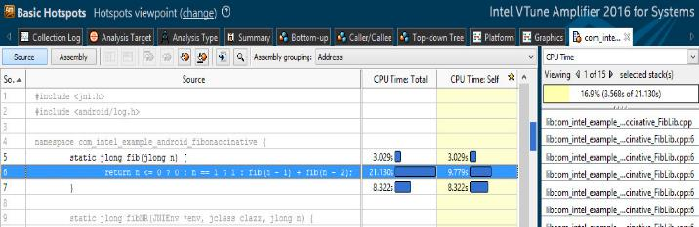
Basic Hotspots Start Here - Makes It Easy
#1 used feature
Easiest feature to use
Enables the most important feature of identifying the hotspot
Works on non-rooted (and rooted) Intel® architecture devices
Collects samples using OS-timer event for a specific application/process
Associate samples to: Module/thread/function C/C++ source or assembly JITted Java/Dalvik functions/ART functions/assembly/dex/source
Collects User Mode Stacks (default)
Notes:
On Non-Rooted Devices it requires the App is made “Debuggable”. But… but be sure to compile your C/C++ in Optimized Mode
This feature requires a rooted phone and instrumed Dalvik engine (ART is not supported yet….). Only PSI/MCG(Atom) builds have the Instrumented version of Dalvik. The OTC builds which support Haswell and some Atom Tablets is not instrumented. The patches to apply to the Android source tree for Dalvik are available.
Stacks to Java/Dalvik Functions are the “real” stacks that Dalvik Creates – not the Java function call to Java function the user might expect – based on the way he coded it.
Java/Dalvik Support Requires PreInstallation

Slide 14
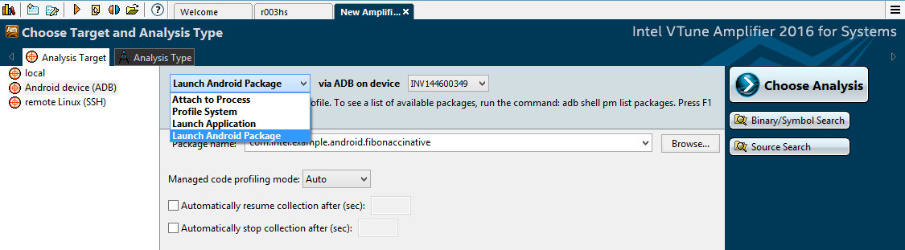
Basic Hotspots Step 2) Create Project in Intel® VTune™ Amplifier
Create Project in VTune Amplifier
set target type: “Android Device (ADB)”
set target type: Launch Android Package
set target system: Your device
set Package or Process Name
Optionally set other options
Notes:
Re: amplxe-cl --collect [atom-general-exploration | snb-general-exploration] [Other Options] --target-system=android
In the next version the POR is that the option will be –collect general-exploration vs. proc-general-exploration

Slide 15
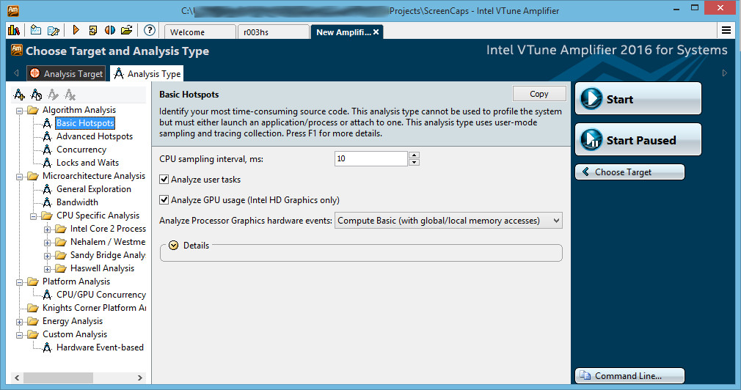
Basic Hotspots Step 3) Start Hotspot Analysis
Click “Launch New Analysis” via play button Then select “Basic Hotspots” under “Analysis Type” Then click “Start”

Slide 16
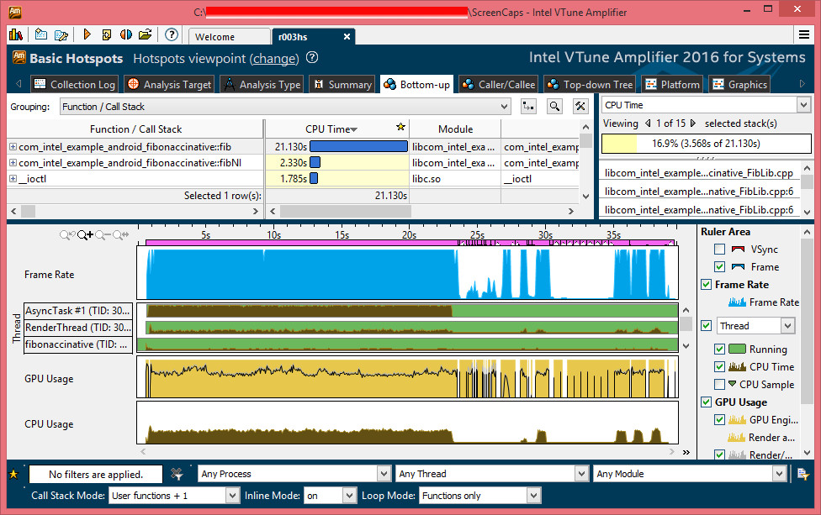
Basic Hotspots Step 5) Identify hottest functions

Slide 17
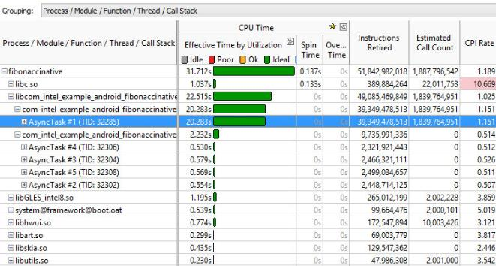
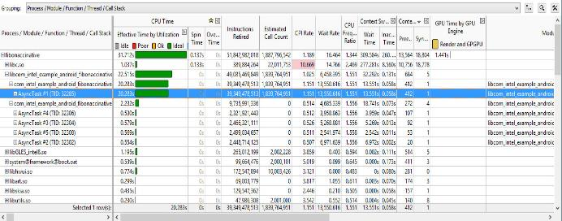
Advanced Hotspots To get more information
Identifies the hotspot using hardware counters (PMU) of Intel® processors
Allows system-wide collection Allowing you to see all processes running on system
For single application can collect: User-Stacks + Kernel-Stacks Context Switches Call Counts
Associate samples to: Process/Module/function Core/thread C/C++ source or assembly JITted Java/Dalvik functions/assembly/dex/source
System Wide:
amplxe-cl --collect advanced-hotspots --duration=<N> --target-system=android
Stacks, Context & Counts:
amplxe-cl –collect advanced-hotspots -knob collection-detail=stack-and-callcount –-target-process=<appName> --target-system=android
Notes:
PMU = Performance Monitoring Unit
Things in bold are “not” available in the “Hotspots” view

Slide 18
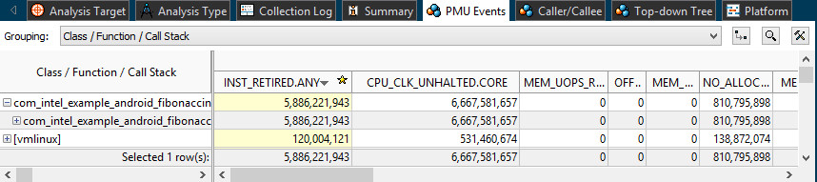
General Exploration To Diagnose Microarchitecture Bottlenecks
Uses hardware counters (PMU) to identify microarchitectural issues in your system/application
Makes it easy to select appropriate counters for each Intel® microarchitecture to find issues in…
Memory (Cache, TLB, Reissues, Bus-Locks)
Branch mis-prediction
Machine Clears, Floating Point Stalls
Efficiency (CPI, uOp(s)-Retired)
Applies Formulas/Heuristics developed by Intel engineers to highlights issues
Easy to Interpret – If it is Pink – Examine in more detail
Notes:
Note: Today the user must either type:
atom-general-exploration
for First Generation Atom – up to CLT+
& 22nm ntel Atom Processors (codenamed: Silvermont)
….or….
snb-general-exploration
for 4th Generation Intel Core Processors (codenamed: Haswell)
In the next version – the POR is the user will just type
general-exploration

Slide 19

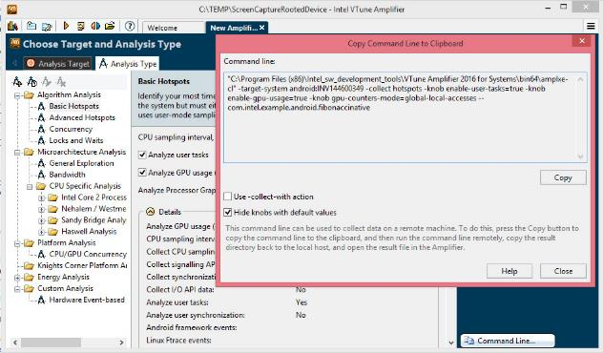
How to Collect
Via the command line
amplxe-cl --collect hotspots --target-process=<appName> [Other Options] --target-system=android
amplxe-cl --collect advanced-hotspots [Other Options] --target-system=android
amplxe-cl --collect [atom-general-exploration | snb-general-exploration] [Other Options] --target-system=android
Via the GUI
Attach device to host – via adb
Create Project in VTune and set target system
Click “Launch New Analysis” then Select Analysis Type then click “Start”
Wait till collection finishes or click Pause, Resume, or Stop Collection.
Click “Command Line….” – dialog will display the Command Line for that analysis type
Notes:
Re: amplxe-cl --collect [atom-general-exploration | snb-general-exploration] [Other Options] --target-system=android
In the next version the POR is that the option will be –collect general-exploration vs. proc-general-exploration

Slide 20
Power Analysis
Using Intel® Energy Profiler in Intel® VTune™ Amplifier for Systems

Slide 21
Intel® Energy Profiler Energy and Power Profiler for System Software Developers
Optimize software for extended Battery Life
Find the system behaviors that waste energy
Interrupts mapped to the IRQ/device
Timers mapped to the scheduling process
Data correlated with Android Wake Locks
Available now for Linux and Android
Part of Intel® System Studio
Requires specific SOCs. On Android, a rootable OS is required with version compatible device drivers. See release notes for details.
Get Actionable Data to Extend Battery Life
Notes:
Unlike other tools that measure average power usage, Intel® Energy Profiler identifies the cause of the wake ups that waste energy. Interrupts are mapped to the IRQ/device and timers are mapped to the process that scheduled them. This gives you actionable information to reduce / consolidate wake-ups and save energy by remaining in a low power state for a longer period of time.
Device State Data – Power-up Only What Is Needed
See what devices are using power and when. Make sure unused devices are off. See if the correct device is being used. E.g., is audio decode is running on the CPU when it should be on the audio decode unit? (Android only)
Correlated Data Provides Clues to the Root Cause
See multiple metrics on the same timeline for faster diagnosis of the root cause.

Slide 22
CPU C-States / P-States
P0 - CPU active at highest frequency (HFM)
Pn - CPU active at lowest frequency (LFM)
C0 - CPU active (In any P-state)
P0
CPU Active
P1
C0
Pn
Power Higher
C1
C1 - Core clock is Off
C3/C4 - Reduced Voltage, Partial L2 cache flush
C6 - Core Off, L2 cache flush, state saved to SRAM
CPU Sleep
C2
Latency Greater
C3
C4
The deeper the sleep state
more power saving
but longer to wake up
C6
22
Notes:
for the purpose of saving power,
when CPU is running, you want P state to be as low as possible
when CPU is not running, you want C state to be as low as possible
At C6 state, the CPU consumes nearly zero power
But the trade off is, you may end up with lower performance, and longer latency leading to bad user experience
such as UI slow response

Slide 23
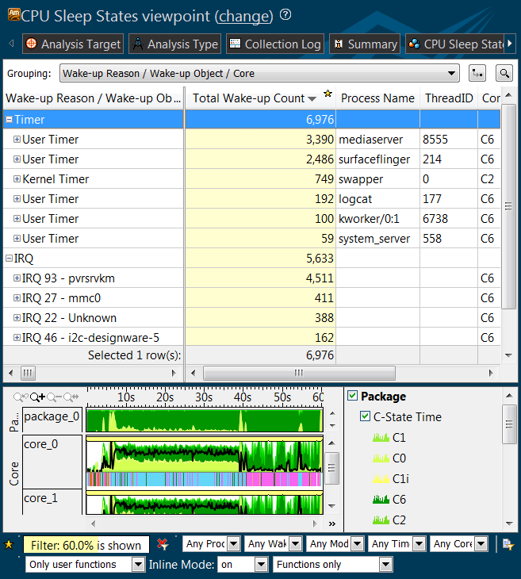
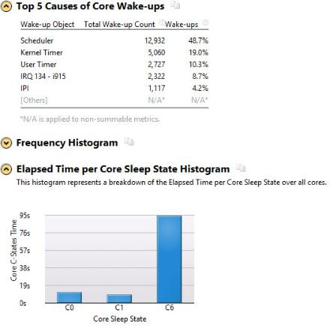
Find Process/Thread Waking System up
C-State Wakeup
Identify the object which woke the CPU up the most often
Reduce the # of wakeups
Identify if the Processor was asleep (C1-C6) mostly or awake (C0)

Slide 24
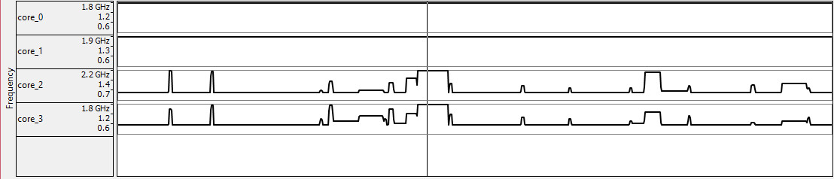
Determine the CPU Frequency
Small Increases in Processor Speed Results in Large Increases in Power
Determine when the CPU Frequency went up
Determine what frequency the CPU was running at and for how long…
Hovering the mouse cursor over a point in the timeline will bring up a pop-up box showing more detailed information such as specific measured frequency at that measurement time.

Slide 25
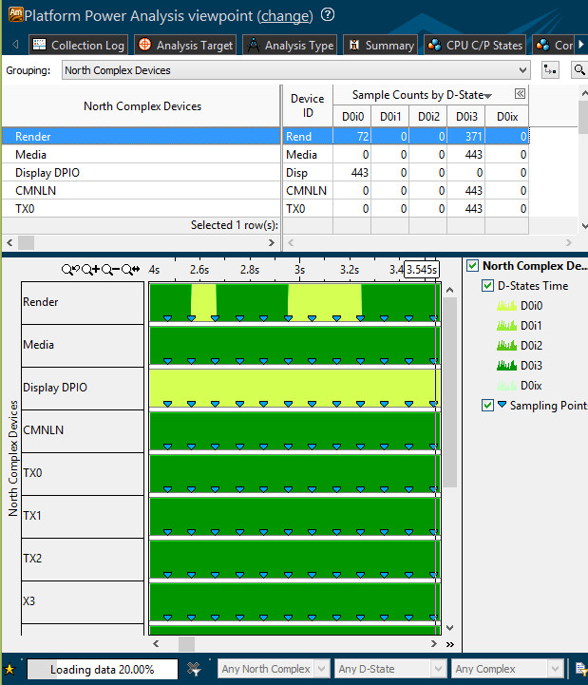
Component Device States Find Components Wasting Power
Intel Device States:
DOi0 = On
DOi1-DOi2 = Intermediate
D0i3 = Off
Find:
Which Devices are on/off?
For this example no media use and only periodic rendering?
When they got turned on/off?
When a device is not in use… the software needs to turn it off
Notes:
North Complex vs South Complex

Slide 26
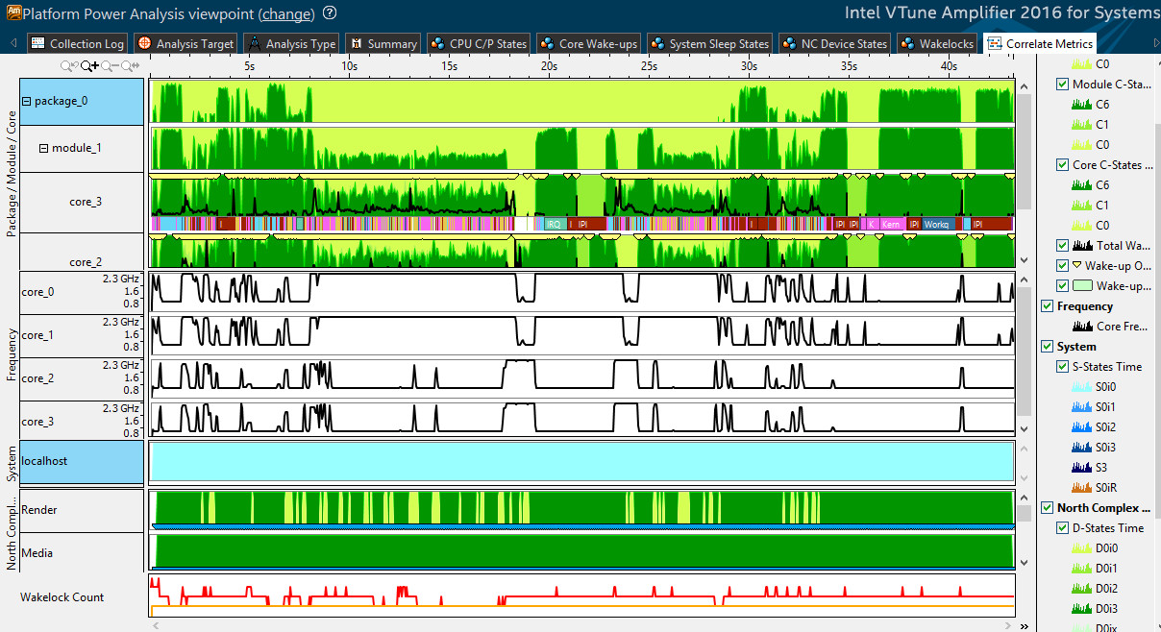
Correlate CPU Frequency, Sleep State, Wake-up Objects, etc...

Slide 27
SoC Watch for Android
Command Line Tool focused on Power Analysis
Correlates key hardware and OS data providing complete system view
Selects the best collection method based on user input
Tracing: 100% accurate
Collects every state change
Snapshot: minimum overhead
Read at start and end of collection, provide difference
Polling: reads values 10 times/sec (configurable)
Notes:
Note: Talking about SoCWatch Publicly is interesting – as there are currently no Publicly available Silvermont Systems running Android, that are rootable with the needed device drivers on them. There are platforms/devices available under NDA.

Slide 28
Example Command Line Usage
./socwatch –f sys –f wakelocks –t 10
-f sys // collects all metrics
-t 10 // defines duration of collection
Snapshots , Traces PStates for 10 seconds, create default SocWatchOutput files
Import into VTune Amplifier on host via:
adb pull <path-on-target>/SocWatchtOutput.sw1
amplxe-cl -import ./SocWatchOutput.sw1 –r <project name>
Open Results in VTune Amplifier GUI
More details in SoCWatchForAndroid_v1_3_0.pdf

Slide 29
Summary
Capabilities of VTune Amplifier 2016 for Systems on Android*
To Identify Performance Issues
Hotspot, Advanced-Hotspots, General Exploration
Other Advanced Options(Custom Collections, Regressions, Frames)
To Identify Power Issues
CPU Wake-ups, Frequency, Device States, Wakelocks
To Zoom In on your Issue via the GUI
Grouping, Filtering, Sorting, Comparing
Workflow for
Performance and Power Analysis Steps
Collecting
Viewing Data

Slide 30
Call to Action
Intel® System Studio 2016 provides deep system-level insight into power, reliability and performance to help accelerate time to market of Intel Architecture-based embedded and mobile systems
For other versions contact:
Your Intel representative or …
intelsystemstudio@intel.com
Note: Most features presented here require access to a rootable Android* device, and version compatible device drivers.
For more information, to evaluate, or purchase: http://intel.ly/system-studio

Slide 31
Additional Resources
http://intel.ly/system-studio
http://software.intel.com/en-us/intel-vtune-amplifier-for-systems
http://software.intel.com/en-us/intel-energy-profiler
Premier Support: https://premier.intel.com
Forums: http://software.intel.com/en-us/forum/intel-system-studio/
Email: intelsystemstudio@intel.com
Release Notes:
http://software.intel.com/sites/default/files/release_notes_amplifier_for_android_linux.pdf
VTune Amplifier Help Documentation:
http://software.intel.com/en-us/vtuneampxe_2013_ug_lin
SubTopic-> Intel VTune Amplifier User’s Guide : Running Analysis Remotely
http://software.intel.com/sites/default/files/managed/c8/f9/SoCWatchForAndroid_v1_3_0.pdf
http://software.intel.com/sites/default/files/managed/9d/59/WakeUpWatch_v3_1_6.pdf
KB Articles: http://software.intel.com/en-us/articles/intel-system-studio-articles
http://software.intel.com/en-us/articles/android-features-in-intel-vtune-amplifier-2014-for-systems-requirements
http://software.intel.com/en-us/articles/using-intel-vtune-amplifier-on-non-rooted-android-devices
http://software.intel.com/en-us/articles/how-to-use-the-intel-energy-profiler-in-intel-system-studio-2014
31

Slide 32
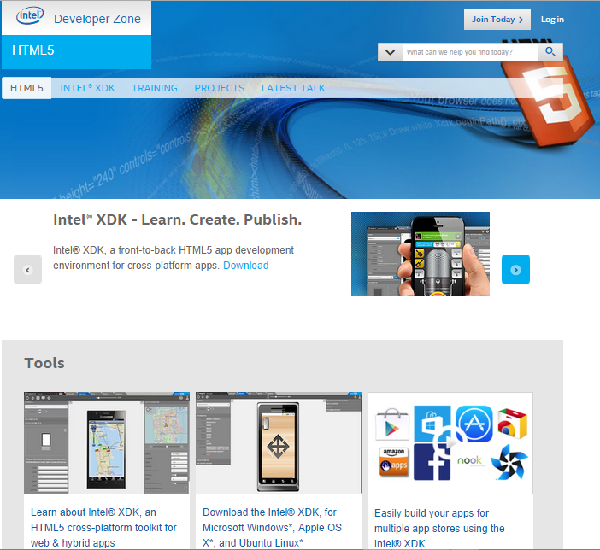
Intel® Developer Zone
Tools. Knowledge. Community.
Free tools and code samples
Technical articles, forums and tutorials
Connect with Intel and industry experts
Get development support
Build relationships
software.intel.com

Slide 33
Q&A

Slide 34
Legal Notices and Disclaimers
Intel technologies’ features and benefits depend on system configuration and may require enabled hardware, software or service activation. Learn more at intel.com, or from the OEM or retailer.
No computer system can be absolutely secure.
Tests document performance of components on a particular test, in specific systems. Differences in hardware, software, or configuration will affect actual performance. Consult other sources of information to evaluate performance as you consider your purchase. For more complete information about performance and benchmark results, visit http://www.intel.com/performance.
Cost reduction scenarios described are intended as examples of how a given Intel-based product, in the specified circumstances and configurations, may affect future costs and provide cost savings. Circumstances will vary. Intel does not guarantee any costs or cost reduction.
This document contains information on products, services and/or processes in development. All information provided here is subject to change without notice. Contact your Intel representative to obtain the latest forecast, schedule, specifications and roadmaps.
Statements in this document that refer to Intel’s plans and expectations for the quarter, the year, and the future, are forward-looking statements that involve a number of risks and uncertainties. A detailed discussion of the factors that could affect Intel’s results and plans is included in Intel’s SEC filings, including the annual report on Form 10-K.
The products described may contain design defects or errors known as errata which may cause the product to deviate from published specifications. Current characterized errata are available on request.
No license (express or implied, by estoppel or otherwise) to any intellectual property rights is granted by this document.
Intel does not control or audit third-party benchmark data or the web sites referenced in this document. You should visit the referenced web site and confirm whether referenced data are accurate.
Intel, [Add words with TM or R from previous pages..ie Xeon, Core, etc] and the Intel logo are trademarks of Intel Corporation in the United States and other countries.
*Other names and brands may be claimed as the property of others.
© 2015 Intel Corporation.

Slide 35
Legal Disclaimer & Optimization Notice
INFORMATION IN THIS DOCUMENT IS PROVIDED “AS IS”. NO LICENSE, EXPRESS OR IMPLIED, BY ESTOPPEL OR OTHERWISE, TO ANY INTELLECTUAL PROPERTY RIGHTS IS GRANTED BY THIS DOCUMENT. INTEL ASSUMES NO LIABILITY WHATSOEVER AND INTEL DISCLAIMS ANY EXPRESS OR IMPLIED WARRANTY, RELATING TO THIS INFORMATION INCLUDING LIABILITY OR WARRANTIES RELATING TO FITNESS FOR A PARTICULAR PURPOSE, MERCHANTABILITY, OR INFRINGEMENT OF ANY PATENT, COPYRIGHT OR OTHER INTELLECTUAL PROPERTY RIGHT.
Software and workloads used in performance tests may have been optimized for performance only on Intel microprocessors. Performance tests, such as SYSmark and MobileMark, are measured using specific computer systems, components, software, operations and functions. Any change to any of those factors may cause the results to vary. You should consult other information and performance tests to assist you in fully evaluating your contemplated purchases, including the performance of that product when combined with other products.
Copyright © 2014, Intel Corporation. All rights reserved. Intel, Pentium, Xeon, Xeon Phi, Core, VTune, Cilk, and the Intel logo are trademarks of Intel Corporation in the U.S. and other countries.
Optimization Notice
Intel’s compilers may or may not optimize to the same degree for non-Intel microprocessors for optimizations that are not unique to Intel microprocessors. These optimizations include SSE2, SSE3, and SSSE3 instruction sets and other optimizations. Intel does not guarantee the availability, functionality, or effectiveness of any optimization on microprocessors not manufactured by Intel. Microprocessor-dependent optimizations in this product are intended for use with Intel microprocessors. Certain optimizations not specific to Intel microarchitecture are reserved for Intel microprocessors. Please refer to the applicable product User and Reference Guides for more information regarding the specific instruction sets covered by this notice. Notice revision #20110804

Slide 36

eventmobi.com/adcboston
Please take a moment to fill out the class feedback form via the app. Paper feedback forms are also available in the back of the room.

